Slide 1

Pizza Sales Analysis
My Name is Ishu Kandpal
I have Made this project on
“Pizza Sales Analysis” and the
Data is taken from Internet.

Slide 2
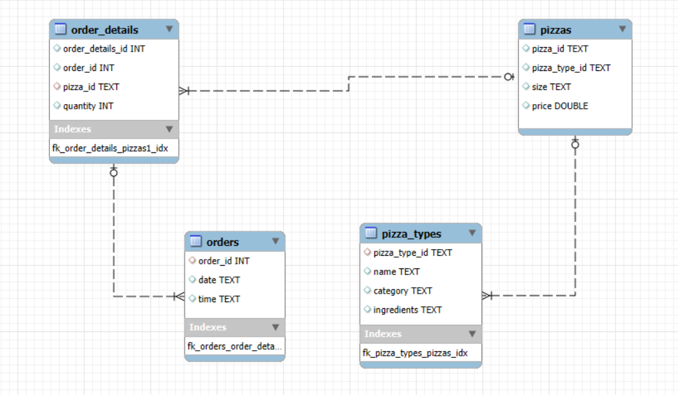
EER Diagram

Slide 3
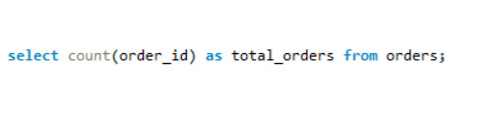
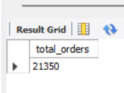
Retrieve the total number of orders placed.

Slide 4
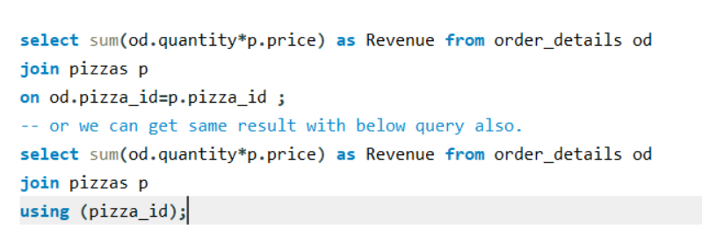
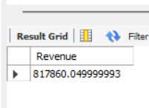
Calculate the total revenue generated from pizza sales.

Slide 5
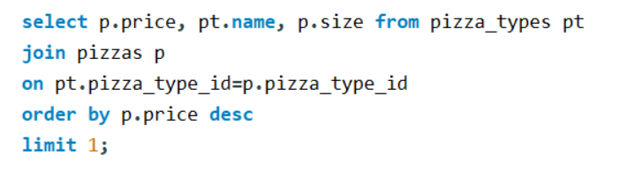
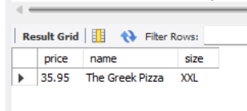
Identify the highest price pizza

Slide 6
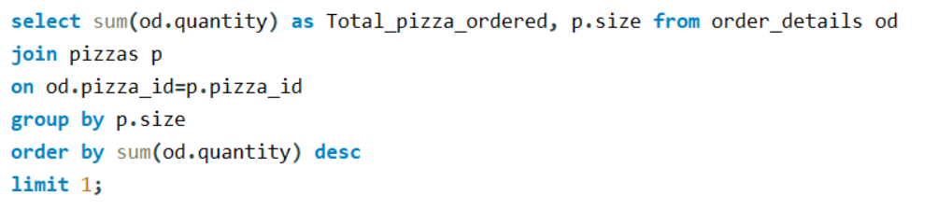
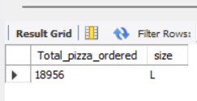
Identify the most common pizza size ordered.

Slide 7
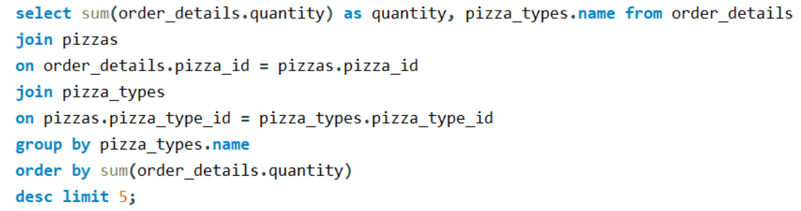
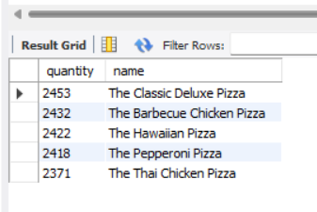
List the top 5 most ordered pizza types along with their quantities.

Slide 8
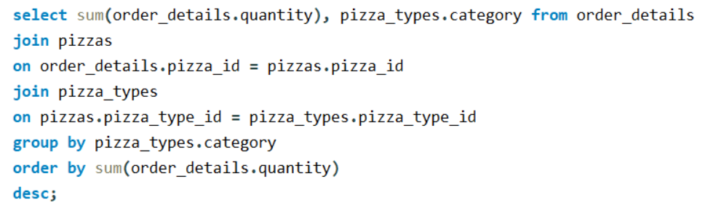
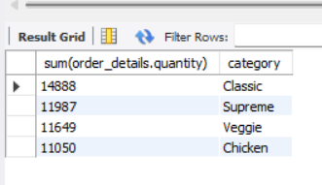
Join the necessary tables to find the total quantity of each pizza category ordered.

Slide 9
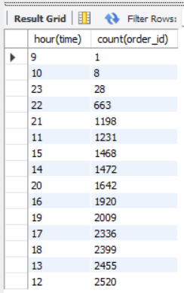
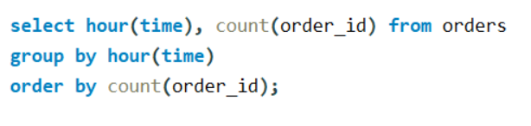
Determine the distribution of orders by hour of the day.

Slide 10
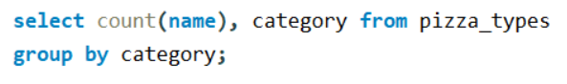
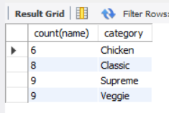
Find the category wise distribution of pizzas.

Slide 11
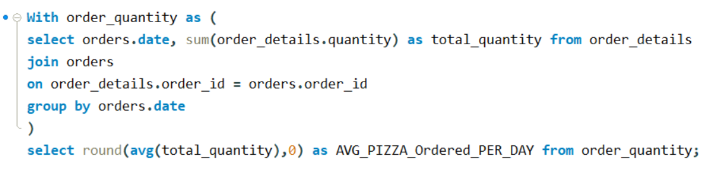
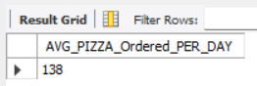
Group the orders by date and calculate the average number of pizzas ordered per day.

Slide 12
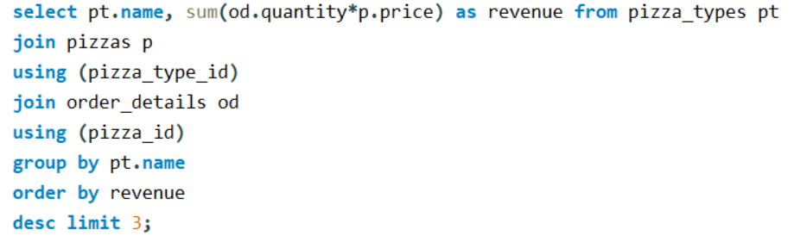
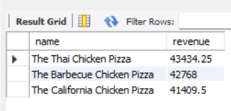
Determine the top 3 most ordered pizza types based on revenue.

Slide 13
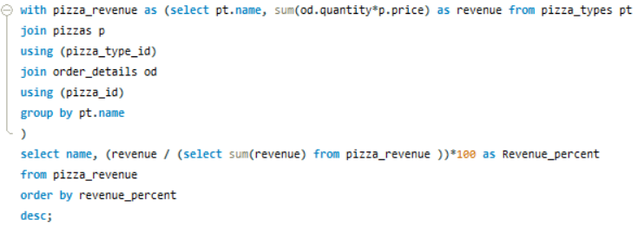
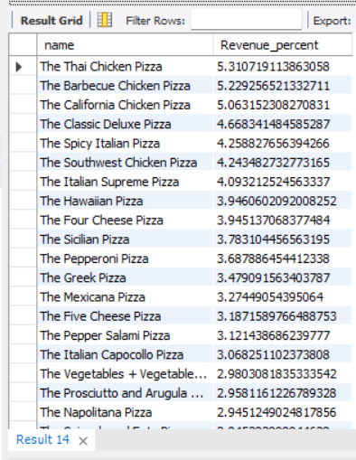
Calculate the percentage contribution of each pizza type to total revenue.

Slide 14
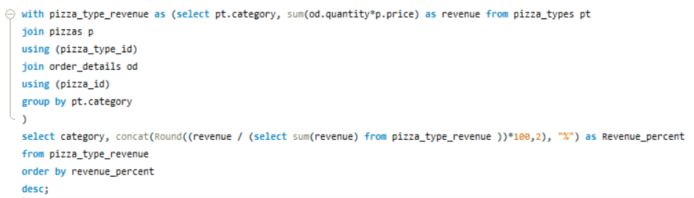
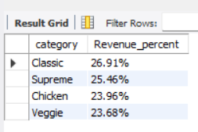
Calculate the percentage contribution of each pizza type to total revenue.

Slide 15
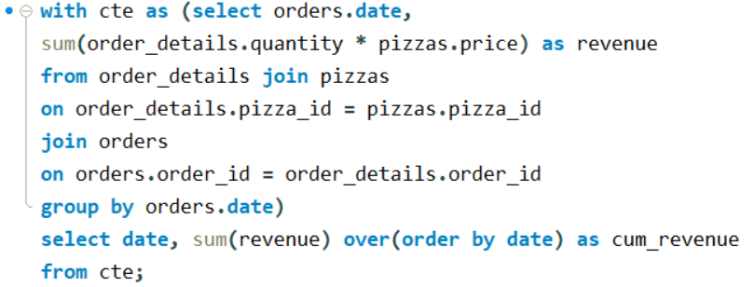
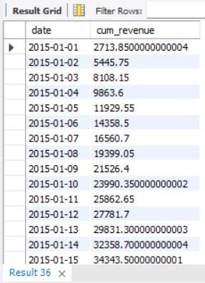
Analyze the cumulative revenue generated over time.

Slide 16
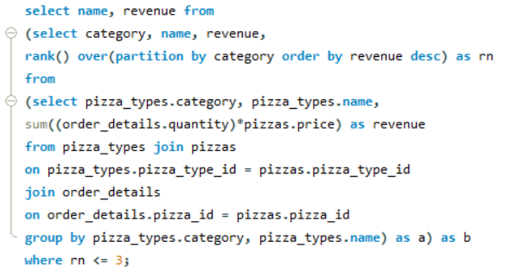
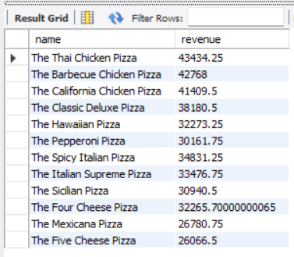
Determine the top 3 most pizza types based on revenue for each pizza category. (using subquery)

Slide 17
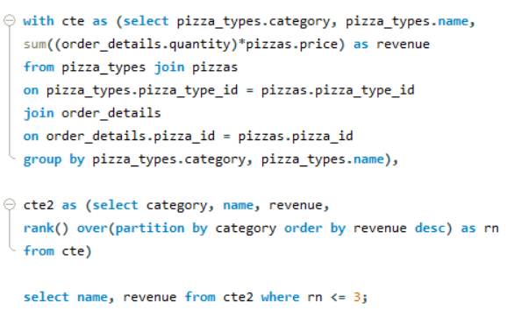
Determine the top 3 most pizza types based on revenue for each pizza category. (using CTE)

Slide 18
Thank You

